Slide 1
Walmart Analysis
Using R
By Lakshmi

Slide 2
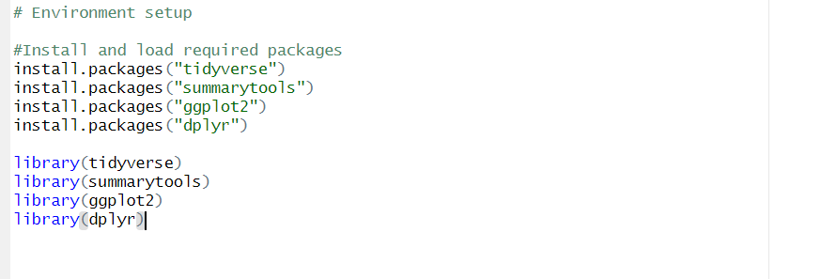
Environment Setup-Analyze Data using R

Slide 3
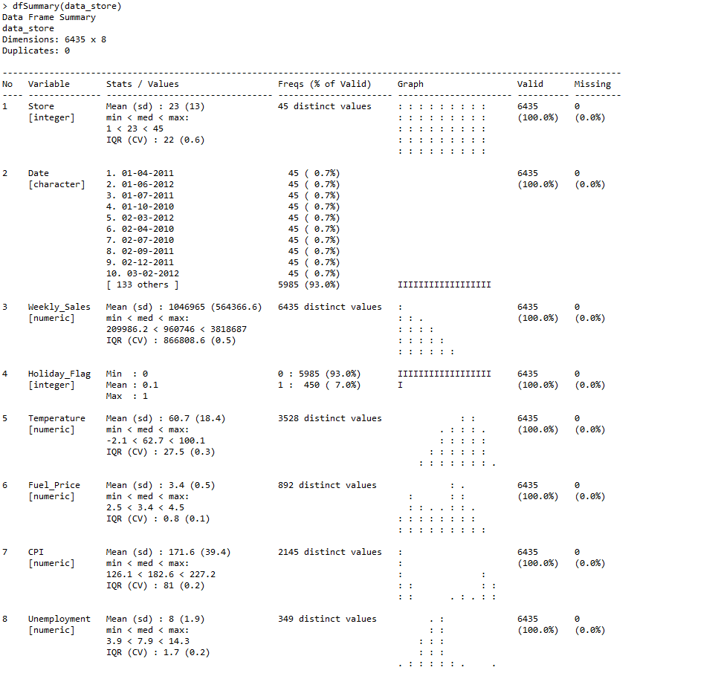
Read and Summarize the data from the input csv file
Read data from csv using read.csv(“File path\\filename.csv”)

Slide 4
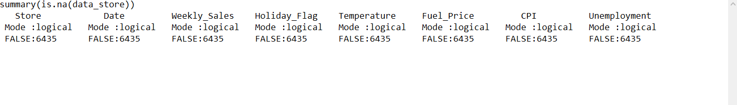
Check for missing values-data suggests False for NA

Slide 5
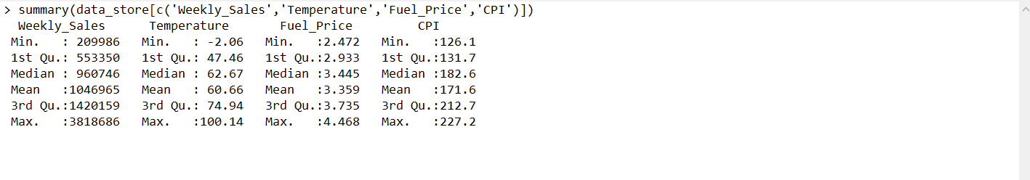
Statistical Analysis-Descriptive Analysis on key columns

Slide 6
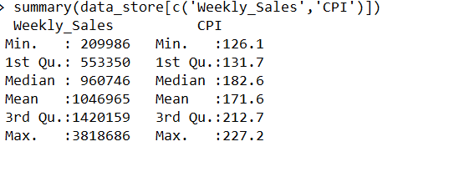
Statistical Analysis-Descriptive Analysis on key columns- Weekly Sales and CPI

Slide 7
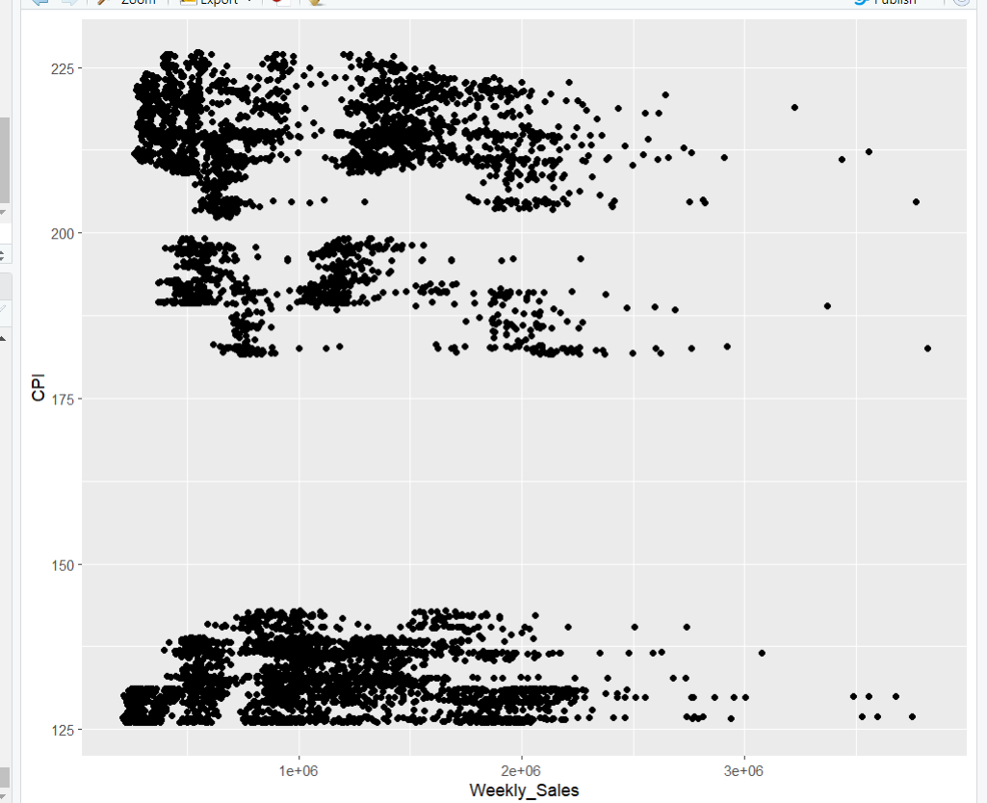
Correlation Analysis – Analyzing weekly sales and CPI
It is difficult to find correlation between weekly sales and CPI

Slide 8
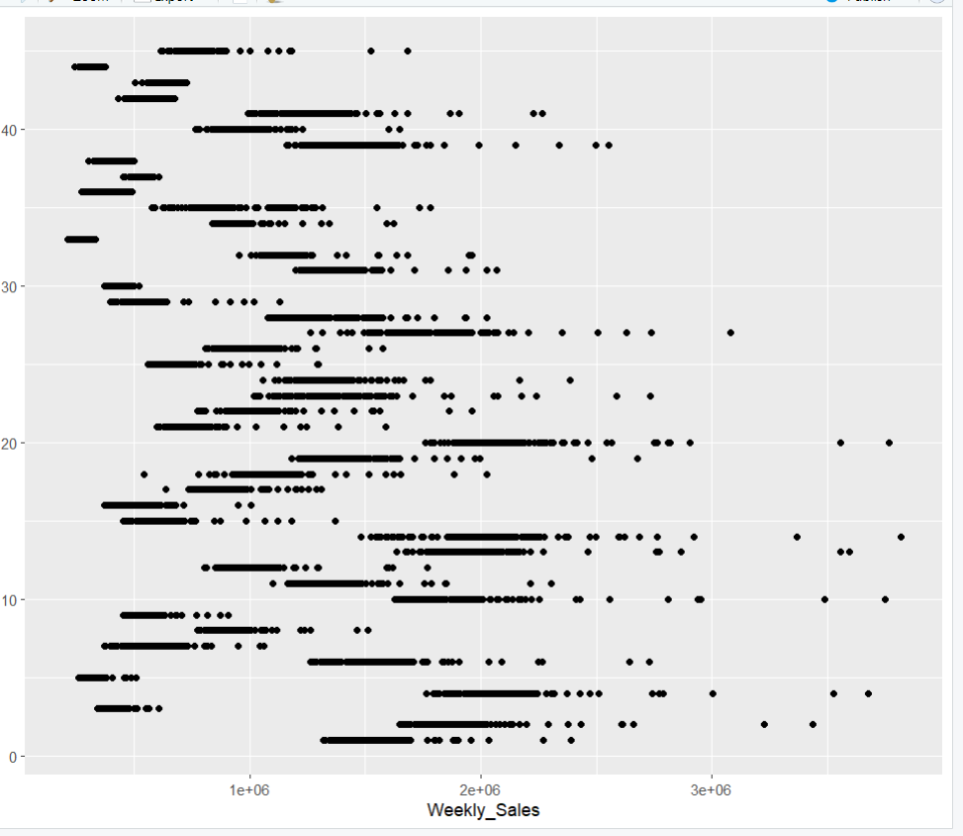
Correlation Analysis – Analyzing weekly sales and Store
We observe few stores stores(01-20) outperformed in weekly sales, compared to new stores with store name >20

Slide 9
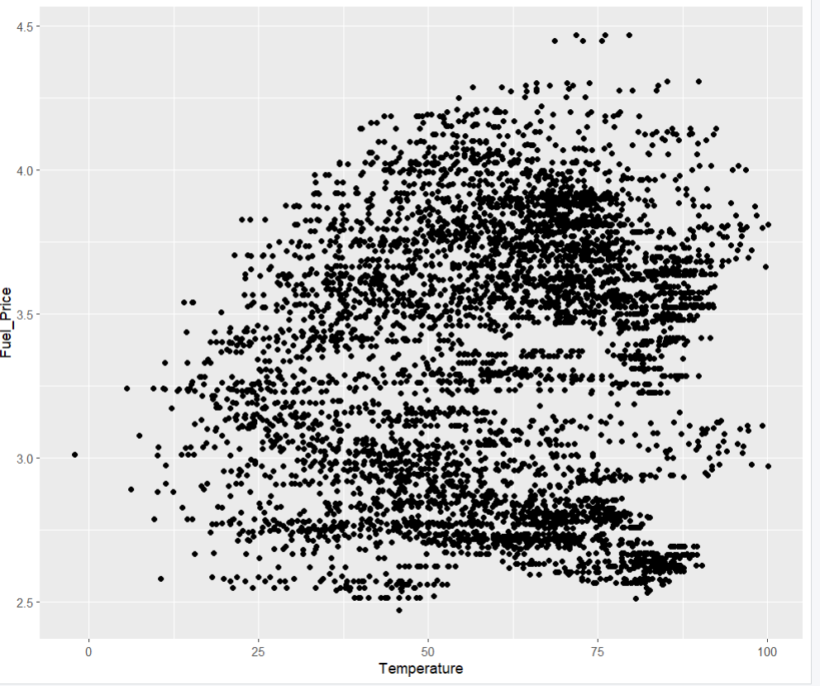
Correlation Analysis – Analyzing Temperature and Fuel Price
We observe, Temperature and fuel price are highly correlated .

Slide 10
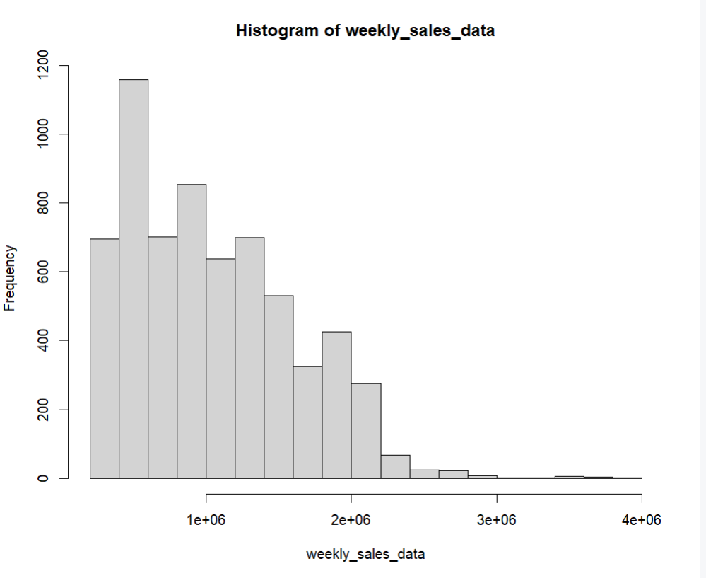
Data Visualization –Histogram
weekly_sales_data <- data_store$Weekly_Sales
hist(weekly_sales_data)

Slide 11
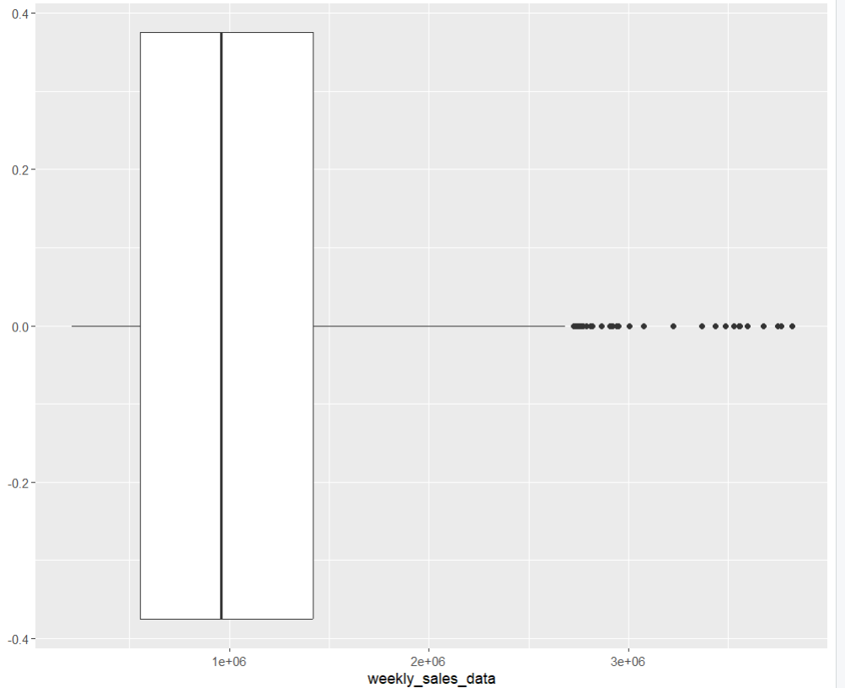
Data Visualization –Boxplot
ggplot(data_store,aes(x=weekly_sales_data)) + geom_boxplot()

Slide 12
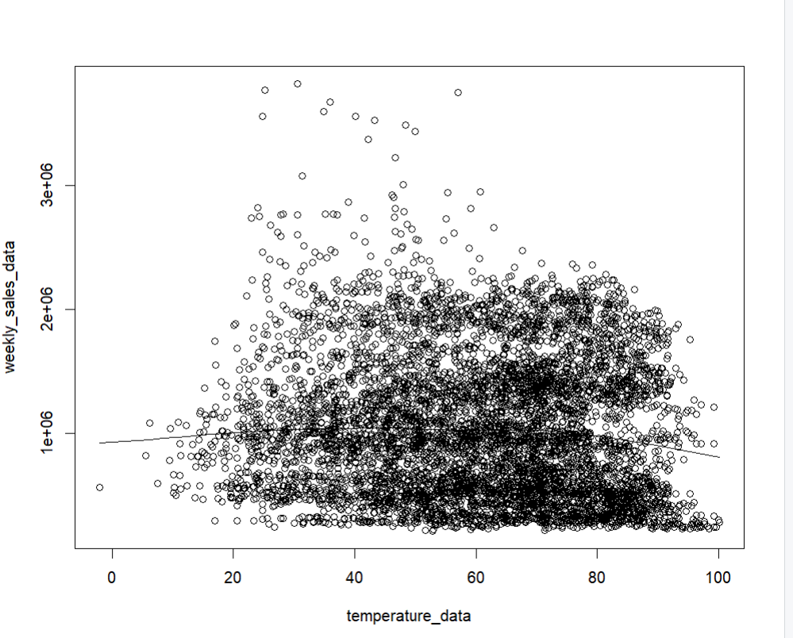
Data Visualization – Scatter Plot
scatter.smooth(temperature_data,weekly_sales_data)

Slide 13
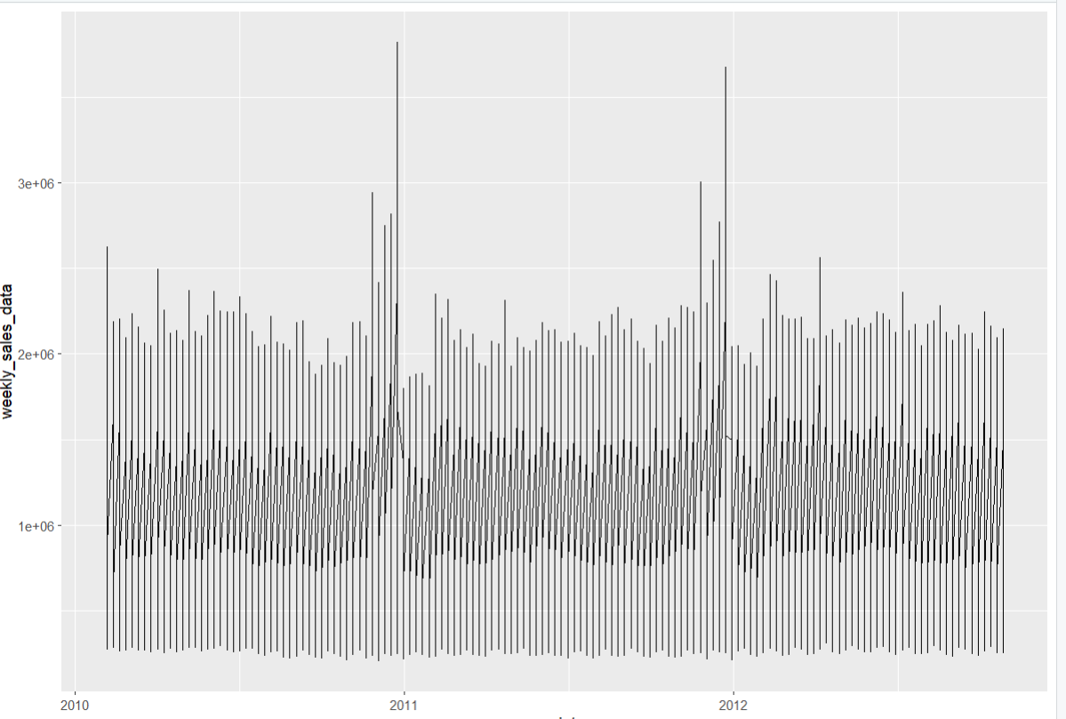
Data Visualization-Time Series
date_formatted <- as.Date(data_store$Date,"%d-%m-%Y")
ggplot(data_store,aes(x=date_formatted,y=weekly_sales_data)) + geom_line()

Slide 14
Any Questions? Thank you

